Slide 1
Node.js
Extending the Programmability of Apigee Edge
Greg Brail
@gbrail
Scott Ganyo
@theganyo
Apigee
@apigee
Notes:
Creative Commons Attribution-Share Alike 3.0 United States License

Slide 2


@gbrail
Greg Brail
@theganyo
Scott Ganyo

Slide 3

youtube.com/apigee

Slide 4

slideshare.net/apigee

Slide 5
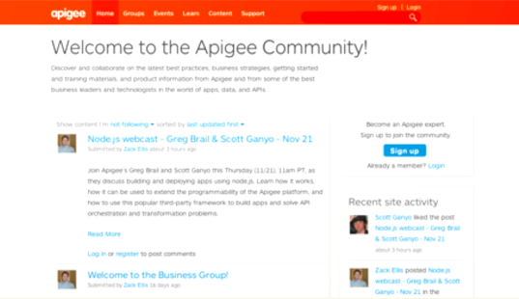
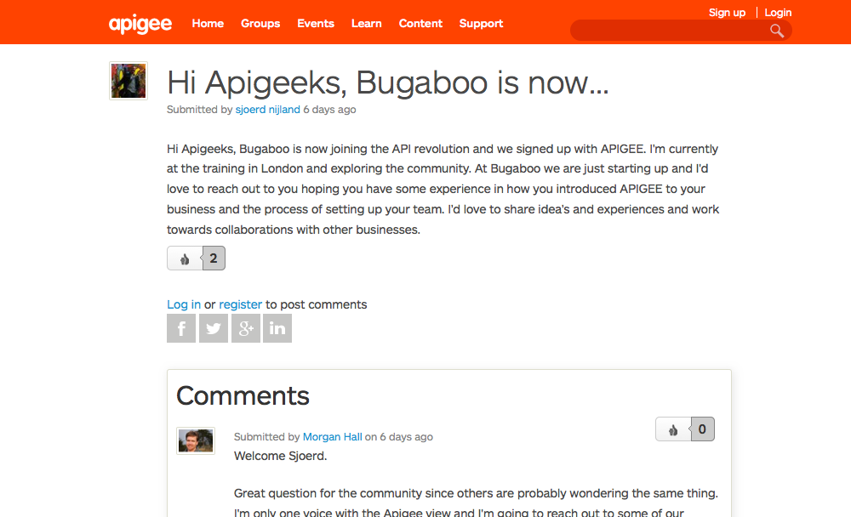
community.apigee.com

Slide 6
Overview
Introduction to the stack
Building a simple API (demo)
Deploying in Edge
Adding API features using Volos (demo)

Slide 7
Introduction to the Stack
Notes:
Introduction To The Stack

Slide 8
Node.js Stack
API Middleware
Volos
Web App and API framework
Argo
Express
Others

Slide 9
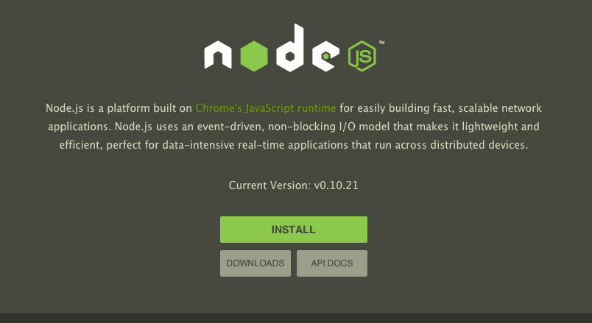
Node.js
Server-side platform for JavaScript
Support for HTTP(s)
Scalable and fast
Huge third-party community
#1 language on GitHub
6,742 modules/year for last four

Slide 10

Argo
A Framework
Describe how to handle URIs
Designed for APIs
Flexible
Add “middleware” to requests and responses
Serve up content
Act as proxy

Slide 11

Volos
Node.js modules for API management
OAuth
Quota
Cache
More to come
MIT License
Multiple back ends

Slide 12
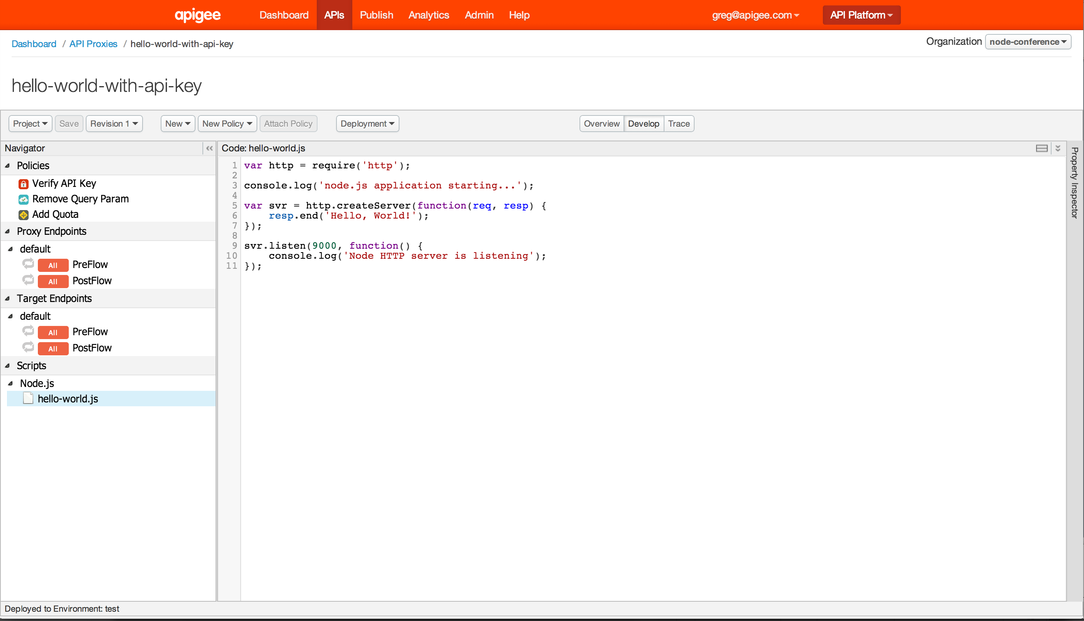
Volos
Deploy Node.js applications to Apigee
Directly from UI
From source code
Third party module support
Combine with other policies

Slide 13
Demo:
Building a Simple API

Slide 14
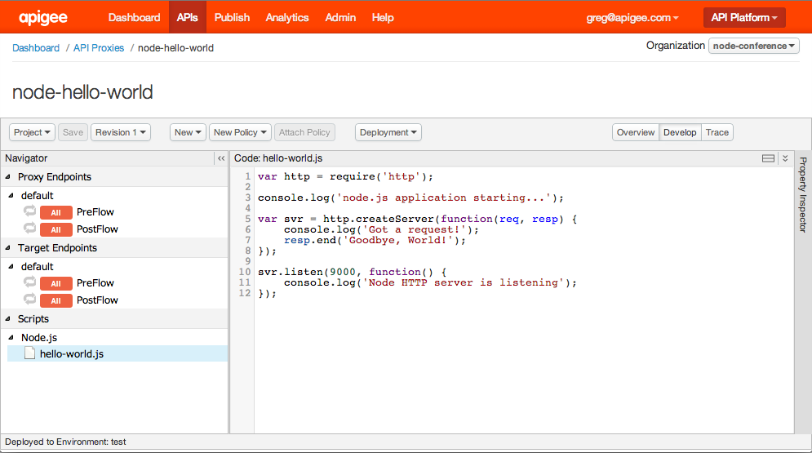
“Hello World”

Slide 15
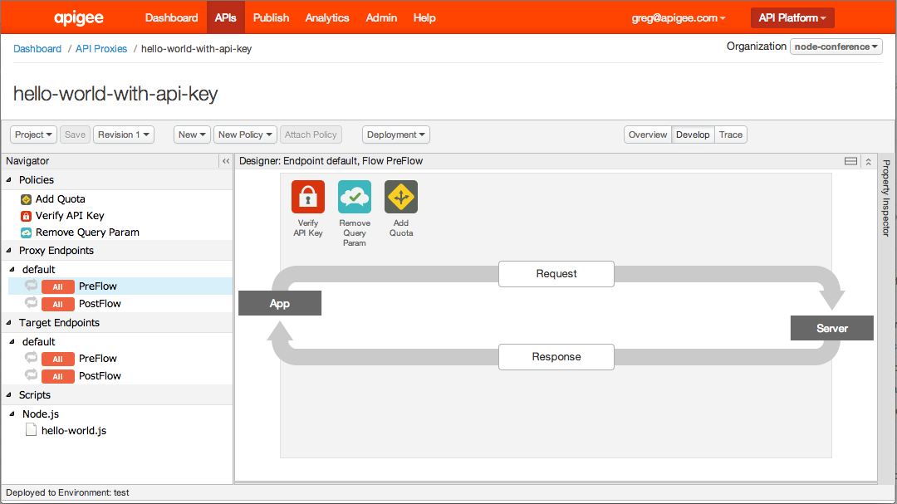
“Hello World” with Policies

Slide 16
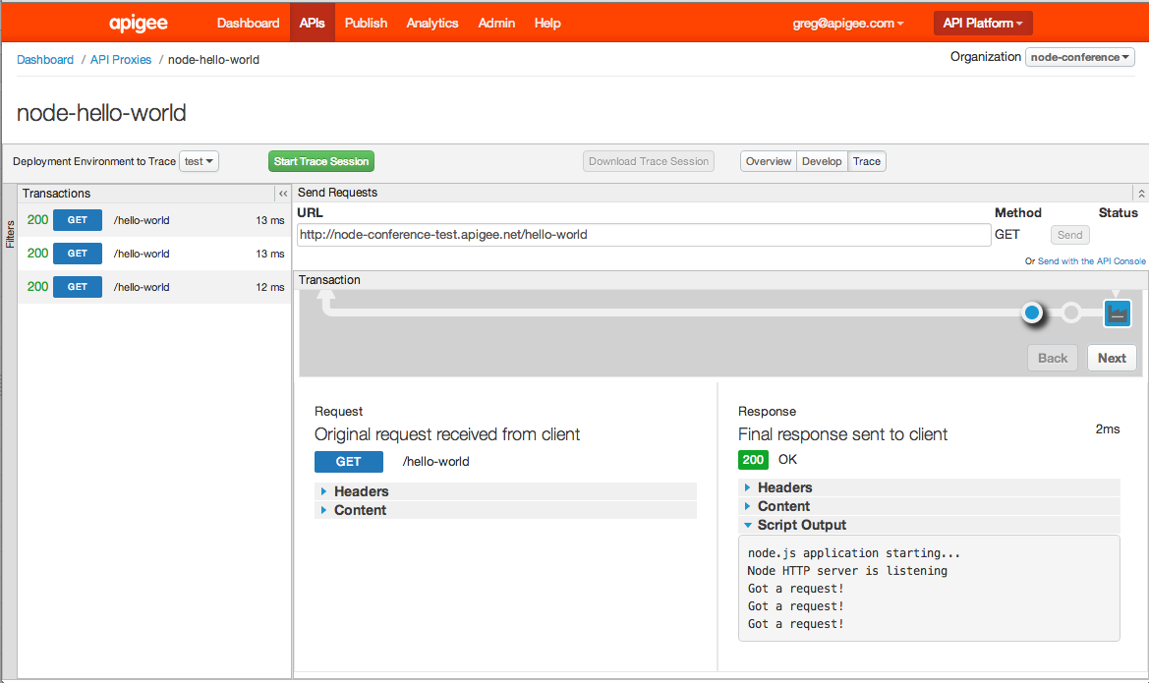
Tracing Script Output

Slide 17
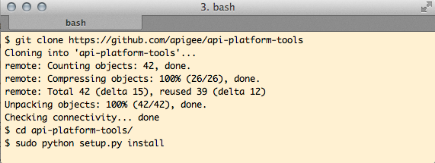
Deploying from the Command Line
Install Apigee deployment tool. . .

Slide 18
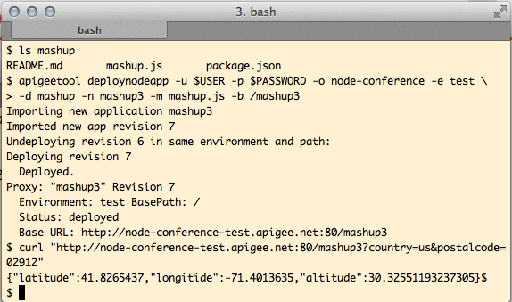
Deploying from the Command Line
-d: Directory where the app is kept
-n: Name to create in Apigee
-m: Name of the “main” script file to run
-b: URI prefix for the app
(NPM modules will be Uploaded along with your app.)

Slide 19
Volos
Notes:
Introduction To The Stack

Slide 20
Introduction to Volos
OAuth 2.0
Add OAuth 2.0 authorization support to any API
Redis and Apigee backends

Slide 21
Introduction to Volos
Quota
Count API calls by time and by any identifier (API key, etc.)
In-memory, Redis, and Apigee backends

Slide 22
Introduction to Volos
Cache
Cache arbitrary data
In-memory and Redis backends

Slide 23
Introduction to Volos
On GitHub and NPM now
More to come
Concurrency management
More security features
Maybe even XML. . .

Slide 24
Demo:
Volos App

Slide 25
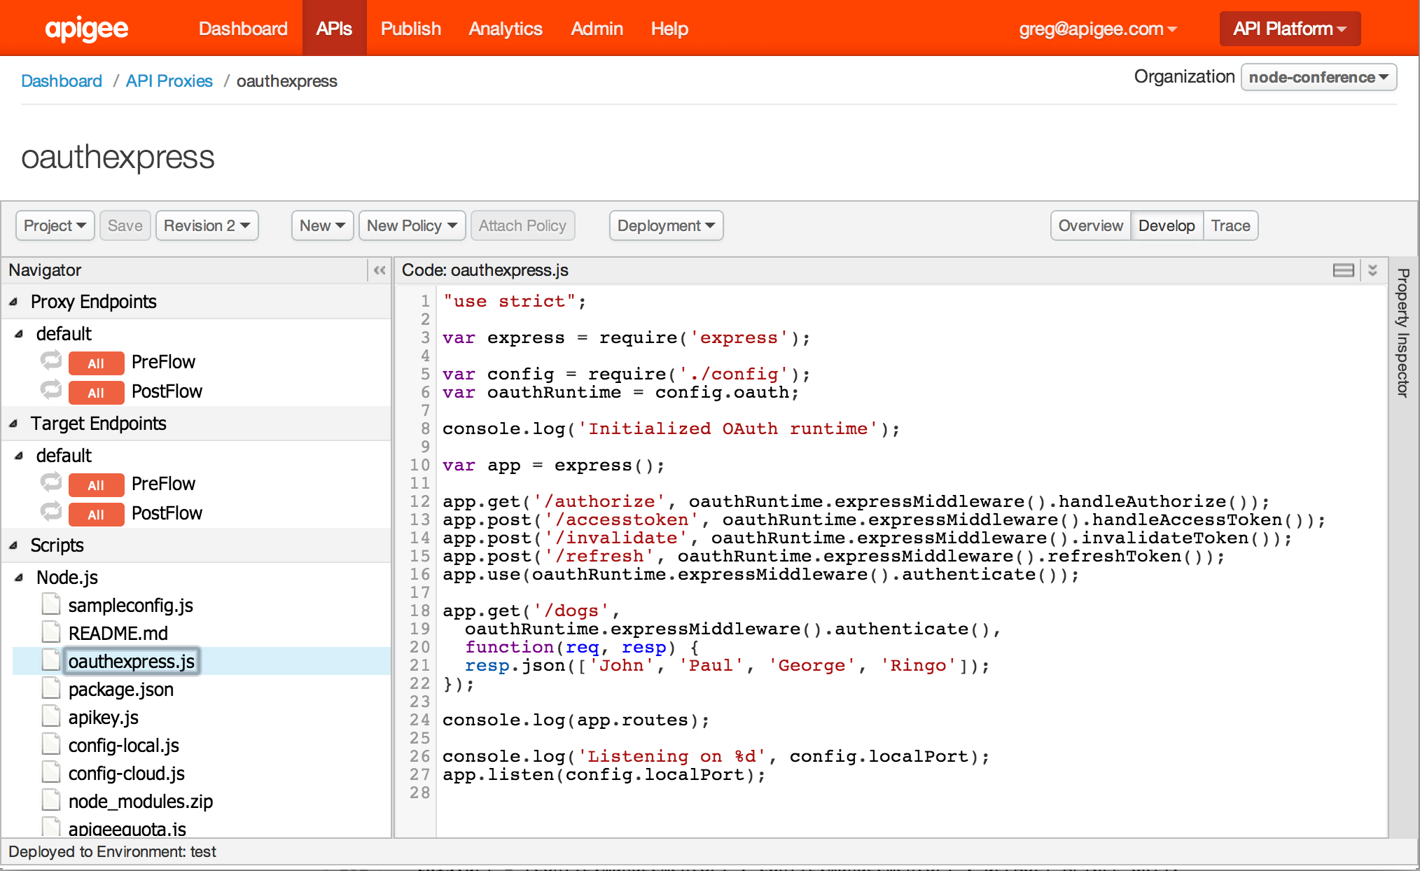
Volos API with OAuth

Slide 26
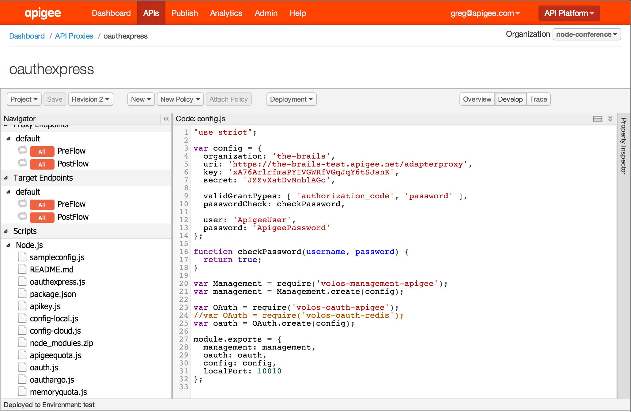
Volos Configuration

Slide 27
Resources
Apigee Node.js Docs
http://apigee.com/docs/gateway-services/content/developing-nodejs-applications-api-platform

Slide 28
Resources
Volos
https://github.com/apigee/volos
Apigee Node.js Sample Apps
https://github.com/apigee/node-samples
Apigee Platform Tools
https://github.com/apigee/api-platform-tools

Slide 29
More Resources
Samples
https://github.com/apigee/node-samples/tree/master/node/hello
https://github.com/apigee/node-samples/tree/master/node/mashup
https://github.com/apigee/volos/tree/master/samples/webinar
Argo – API and proxy framework
https://github.com/argo/argo
Trireme – Node.js runtime for Java
https://github.com/apigee/trireme

Slide 30
Q&A

Slide 31
community.apigee.com

Slide 32
THANK YOU
Questions and ideas to:
@gbrail
@theganyo
http://community.apigee.com

